Slide 1
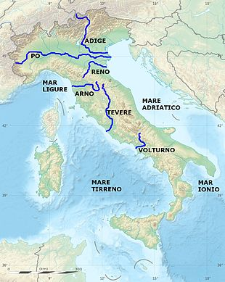
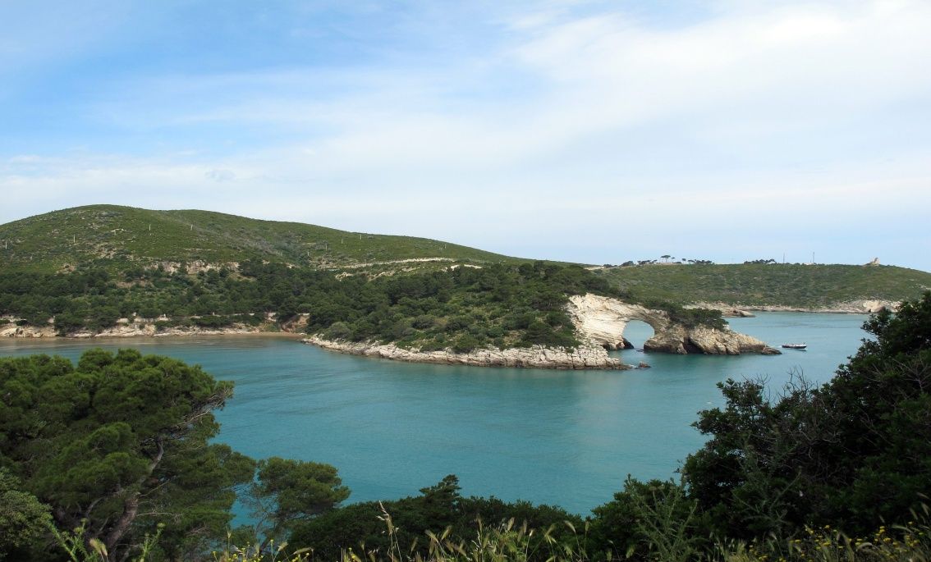
A cruise among the Venetian Villas of the Brenta Riviera
To visit Italy through the navigating system is not so typical but it can be very interesting and charming.
Thanks to the many water ways running through our wonderful country, you can choose river routes and navigation in lakes and lagoons. They represent one of the best opportunities to appreciate the area, between the plain and the sea.

Slide 2
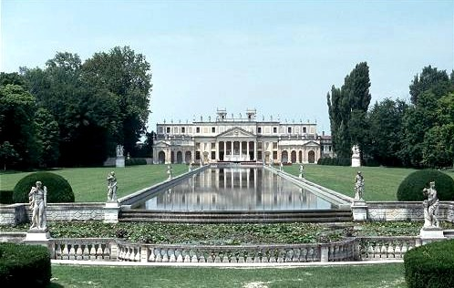
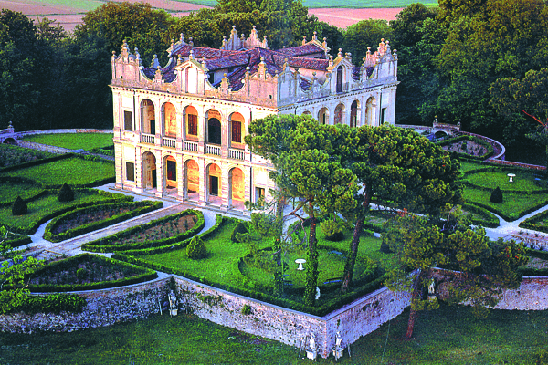
A cruise on the “Riviera del Brenta”
A cruise on the “Riviera del Brenta”, for example, is the perfect occasion to get to know the glamour of 16th-century Venetian culture, a period during which Venice’s finest noble families built summer homes along the quiet river banks.
Today, more than 30 villas remain from the period,
Some of them are open to the visitors.

Slide 3
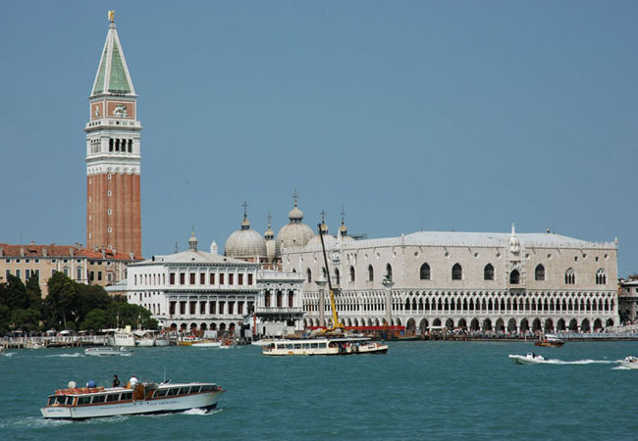
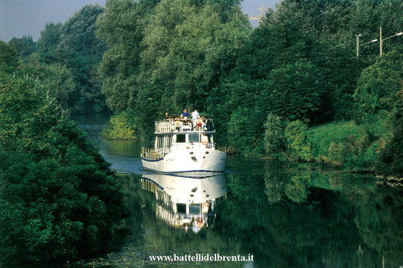
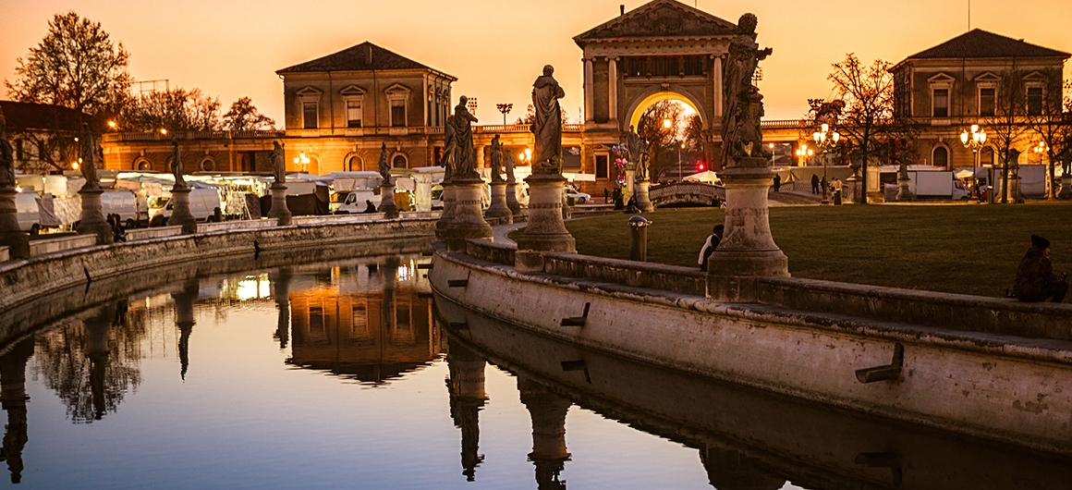
THE BURCHIELLO
Every year, from March to October, tourists can enjoy a mini-cruise through art and history, admiring the Venetian Villas of the “Riviera del Brenta”, from Padua to Venice or the other way round.

Slide 4
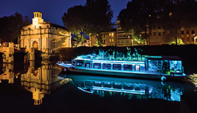
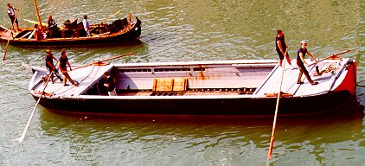
OLD AND NEW BURCHIELLI
In ancient times, Padua and Venice were connected by typical river boats,
called “Burchielli”.
The “Burchiello” was a wooden boat to carry passengers. It had an elegant cabin, decorated with mirrors, carvings of great value and with three or four balconies, carved in a refined way.
It was a typical Venetian boat and it was used by the richest classes of Venice to reach the city from their villas in the country side.
Today the “Burchiello” is no longer made of wood but it is a modern and comfortable ship of 25 m with a capacity of 110 passengers, with a panoramic terrace, bar service and every comforts that tourists can need to enjoy their navigation at the best.
Old Burchiello
New Burchiello

Slide 5
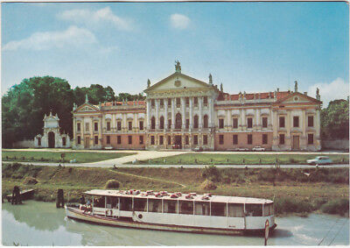
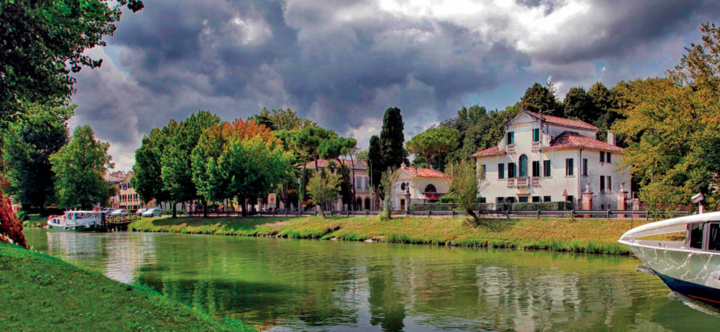
As it used to do in the past, nowadays the”Burchiello” operates as a long-distance touring service on the water way of “Riviera del Brenta”, from Padua to Venice.
It slowly cruises the Brenta waters while tourist-guides on board tell about the history, the culture and the art of the Villas that rise along the river.

Slide 6
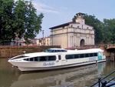
The route of the Burchiello
The photo shows the route taken by the Burchiello from Padua to Venice

Slide 7
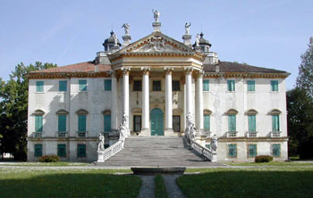
THE MOST IMPORTANT VILLAS
Among the 30 ancient and fascinating Villas along the Brenta River, many of these are still inhabited and cannot, therefore, be visited.
The most famous attractions for tourists are:
Villa Giovanelli
Extensively frescoed, it was built at the end of the 17th century by the Giovanelli family. Its structure matches Palladian features
It has a monumental pronaos of pentagonal shape, with tall Corinthian columns and a tympanum decorated with statues, The imposing staircase added by Massari in 1738 makes its external aspect magnificent.

Slide 8
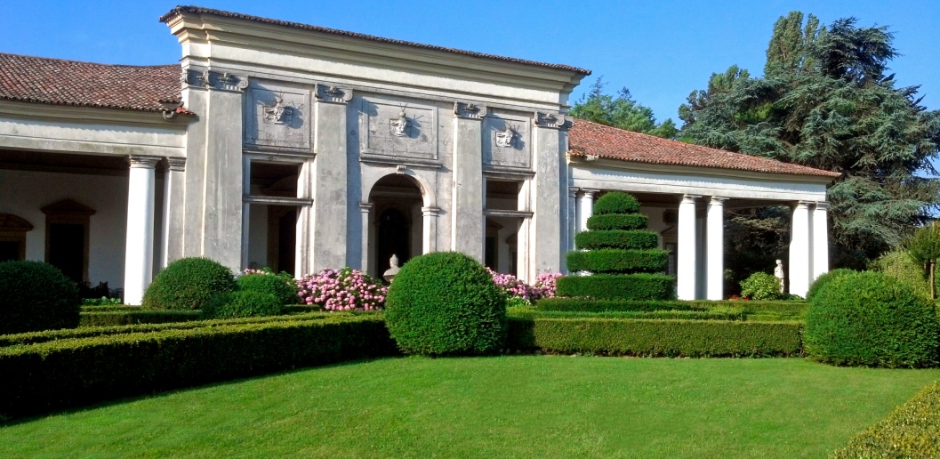
Villa Barchessa Valmarana
The Villa Barchessa Valmarana is all that remains of the 18th-century Villa Valmarana, which originally consisted of two Barchesse: one emerging from each side of the Central Villa.
Until the end of the 17th-century, the “Barchessa” was the part of the villa used for agriculture and where the owners could use the porch to store their boats so they would not disturb the flow of traffic along the Brenta canal,
The villa’s interiors were completely decorated with frescoes so as to demonstrate the ostentatious lifestyle of the Valmarana family.
In the photo, we can see the wide colonnade dominating the garden.

Slide 9
VILLA PISANI
This villa was the Doge’s Palace on the mainland.
It was ordered by the Pisani family as their status symbol.
Rather than a villa, it is a palace decorated with mighty sculptures and paintings by the most famous artists of the 18th century like Giambattista Tiepolo and Pietro Visconti.
It is certainly one of the most famous of the Venetian villas and one of the most important attractions in the Veneto region, able to attract more than 150,000 visitors each year.

Slide 10
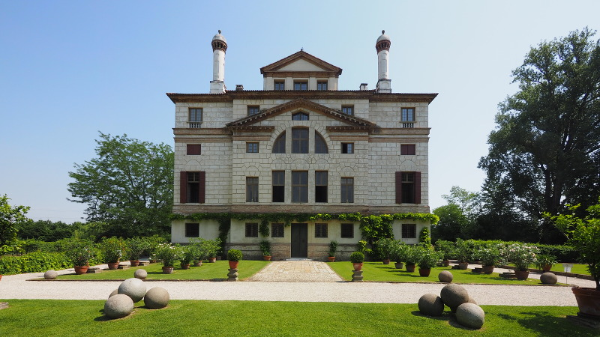
Villa Foscari
It is also called «The Malcontenta» and it is one of the masterpieces of the genius of Andrea Palladio. The Malcontenta is a typical example of a
temple-villa, with a monumental pronaos reflecting
in the waters of the canal.
It was built for Nicolò and Alvise Foscari and it still belongs to the descendants of that noble family. The legend goes that the villa owes its name “Malcontenta” (never happy) to the unhappy soul of the wife of one of the Foscari men, who was exiled here against her will.

Slide 11
This tour on the river is a journey through the beauty of the landscape and the magnificent works of art of our region.
It is unforgettable.

